Slide 1






Project 3: Serverless REST API
with DynamoDB and API Gateway
AWS Solutions Architect - Associate
RESTful API Development
REST API
NoSQL
Serverless
CRUD
Khalid Mohamed Salman

Slide 2













Project Overview
Project Goals
API Type
Build scalable serverless REST API
Implement full CRUD operations
Design NoSQL data management
Apply API security best practices
REST API
Stateless, resource-based HTTP API
Learning Outcomes
RESTful API design principles
Key Technologies
DynamoDB data modeling
API Gateway configuration
API Gateway
Lambda
DynamoDB
S3

Slide 3


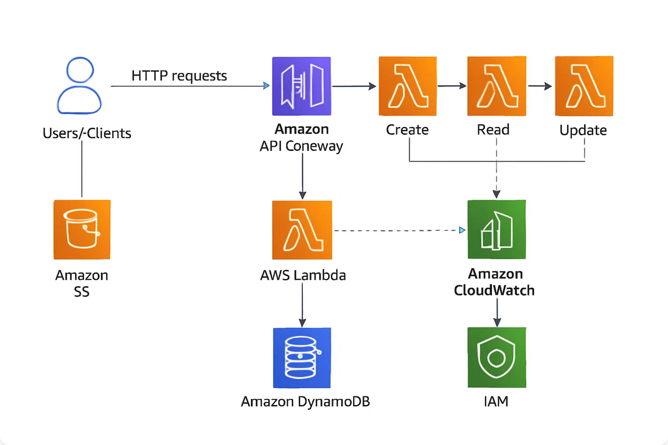



REST API Architecture Diagram
Serverless CRUD API
RESTful endpoints with NoSQL data persistence
Clients
API Gateway
Lambda
DynamoDB
HTTP requests
REST endpoints
CRUD operations
NoSQL storage

Slide 4









Key AWS Services
Amazon API Gateway
AWS Lambda
RESTful API Management
Serverless Compute
Create and manage REST APIs
Execute CRUD business logic
Handle HTTP methods and routing
Automatic scaling and availability
Built-in CORS and authentication
Pay-per-request pricing model
Amazon DynamoDB
Amazon S3
NoSQL Database
Static Website Hosting
Fast and flexible NoSQL storage
Host frontend applications
Single-digit millisecond latency
Static website hosting
Automatic scaling and backup
Global content delivery
IAM for Security
CloudWatch Monitoring
API Keys (Optional)

Slide 5







Implementation Phases
1
Environment Setup
2
DynamoDB Table
Create AWS account and IAM user
Create TodoItems table
Choose AWS region
Configure partition key (id)
Set up permissions
Set up on-demand billing
3
IAM Role & Lambda
4
API Gateway Setup
Create Lambda execution role
Create REST API
Develop CRUD handler function
Configure resources and methods
Configure DynamoDB permissions
Enable CORS and deploy
5
Testing & Frontend
6
Monitoring & Cleanup
Test API endpoints
Set up CloudWatch monitoring
Create HTML frontend
Implement security enhancements
Host on S3 (optional)
Clean up resources

Slide 6






DynamoDB and Lambda Setup
DynamoDB Table Schema
Lambda Function Structure
Table: TodoItems
# Lambda handler function
• Partition Key: id (String)
def lambda_handler(event, context):
• Billing: On-demand
http_method = event['httpMethod']
path = event['path']
• Encryption: Enabled
if http_method == 'GET':
# Read operations
Item Attributes:
elif http_method == 'POST':
• title, description, completed
# Create operations
• createdAt, updatedAt timestamps
elif http_method == 'PUT':
# Update operations
elif http_method == 'DELETE':
# Delete operations
IAM Role Permissions
AWSLambdaBasicExecutionRole
Lambda Configuration
DynamoDB CRUD permissions
CloudWatch Logs access
Runtime Settings:
• Runtime: Python 3.9
• Memory: 256 MB
• Timeout: 15 seconds
Environment Variables:
• TABLE_NAME: TodoItems
• AWS_REGION: us-east-1

Slide 7










API Gateway Configuration
REST API Structure
API Endpoints
Resources:
GET
/todos - List all todos
• / (root resource)
• /todos (collection)
POST
/todos - Create new todo
• /todos/{id} (individual item)
HTTP Methods:
GET
/todos/{id} - Get specific todo
• GET, POST, PUT, DELETE
• OPTIONS for CORS preflight
PUT
/todos/{id} - Update todo
DEL
/todos/{id} - Delete todo
CORS Configuration
Access-Control-Allow-Origin: *
Deployment
Allow-Headers: Content-Type
Allow-Methods: All CRUD methods
Create deployment stage (prod)
Generate invoke URL
Enable API Gateway logging
Configure throttling (optional)
RESTful API Design Principles
Resource-Based
Stateless
HTTP Methods
JSON Format

Slide 8










CRUD Operations and Testing
Create (POST)
Update (PUT)
# Create new todo
# Update todo
curl -X POST \\
curl -X PUT \\
https://api.execute-api.region.amazonaws.com/prod/todos \\
https://api.execute-api.region.amazonaws.com/prod/todos/{id} \\
-H "Content-Type: application/json" \\
-H "Content-Type: application/json" \\
-d '{
-d '{
"title": "Learn AWS",
"title": "Learn AWS - Updated",
"description": "Complete API project",
"completed": true
"completed": false
}'
}'
Delete (DELETE)
Read (GET)
# Delete todo
# Get all todos
curl -X DELETE \\
curl https://api.execute-api.region.amazonaws.com/prod/todos
https://api.execute-api.region.amazonaws.com/prod/todos/{id}
# Get specific todo
curl https://api.execute-api.region.amazonaws.com/prod/todos/{id}
Testing Tools and Response Codes
curl / Postman
200/201 Success
400/404 Client Error
500 Server Error

Slide 9










Monitoring and Security
CloudWatch Monitoring
Security Enhancements
API Gateway Metrics:
API keys for basic authentication
• Request count and latency
AWS Cognito for user management
• 4xx/5xx error rates
Input validation and sanitization
• Cache hit/miss ratios
Rate limiting and throttling
Lambda Metrics:
HTTPS-only communication
• Invocations and duration
• Error rate and throttles
• Memory utilization
Debugging and Logging
CloudWatch Logs analysis
Alarms and Alerts
API Gateway access logging
Lambda function logging
API Gateway error rate > 5%
Error handling and responses
Lambda function errors
DynamoDB throttling events
High response latency
API Security Best Practices
Authentication
Authorization
Input Validation
Rate Limiting

Slide 10








API Best Practices
REST API Design
Resource Cleanup Order
Use proper HTTP status codes
1
Delete API Gateway
Implement consistent error handling
Follow RESTful naming conventions
2
Delete Lambda function
Use JSON for data exchange
Version your APIs properly
3
Delete DynamoDB table
4
Empty and delete S3 bucket
Performance Optimization
5
Delete IAM roles and policies
Enable API Gateway caching
Optimize Lambda memory allocation
6
Delete CloudWatch logs
Use DynamoDB efficiently
Implement pagination for large datasets
Project Deliverables
REST API architecture diagram
GitHub repository with Lambda code
API documentation and testing
Working frontend demo (optional)
Congratulations!
You've built a production-ready serverless REST API
RESTful
Scalable
Serverless
Secure

